Slide 1
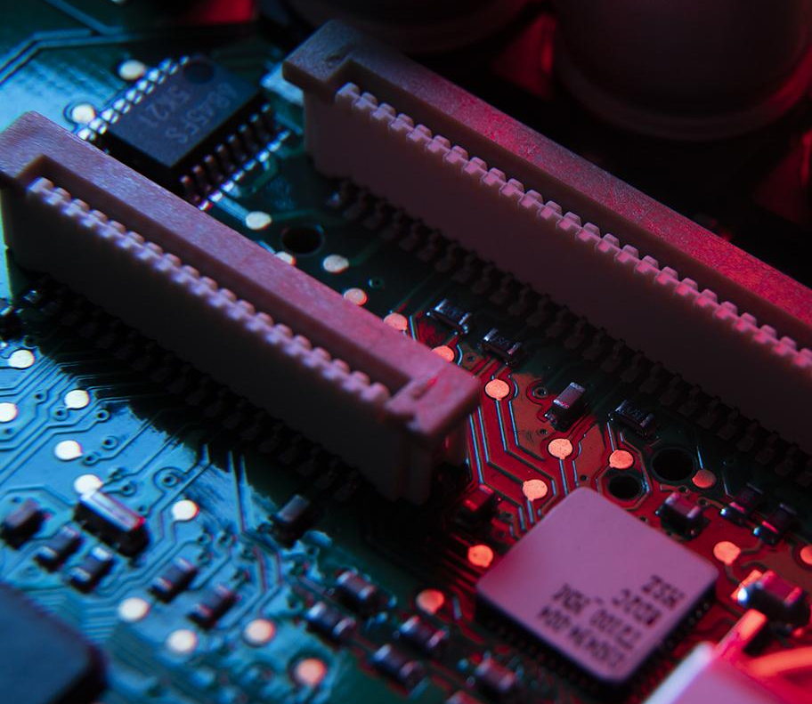
CND Digital Project DSP Slice
Submitted by: Nada, Fagr and Mohamed

Slide 2
Intro
Fagr Ahmed
Nada Waleed
Mohamed Yasser

Slide 3
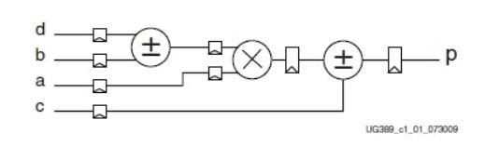
Implementation of DSP Slice
FPGAs are efficient for digital signal processing (DSP) applications because they can implement custom, fully parallel algorithms. DSP applications use many binary multipliers and accumulators that are best implemented in dedicated DSP slices.

Slide 4
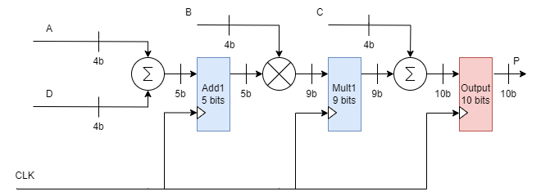
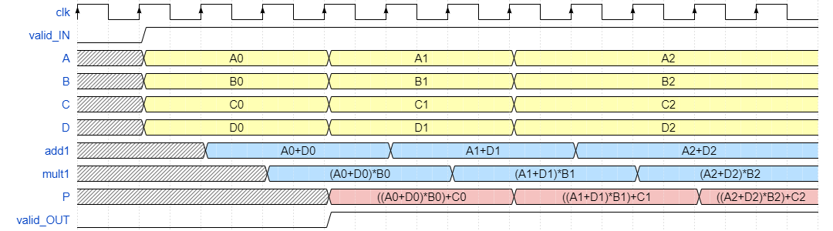
Schematic

Slide 5
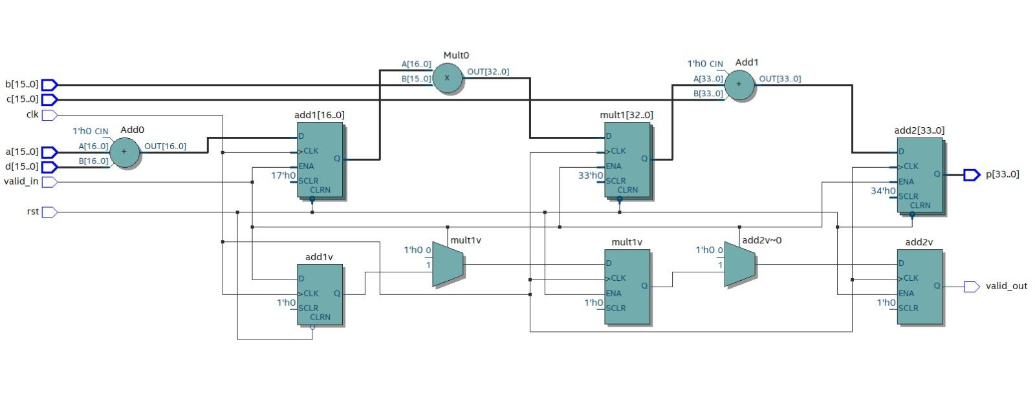
RTL Netlist

Slide 6
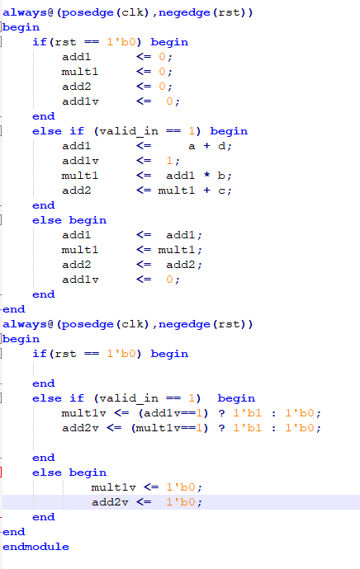
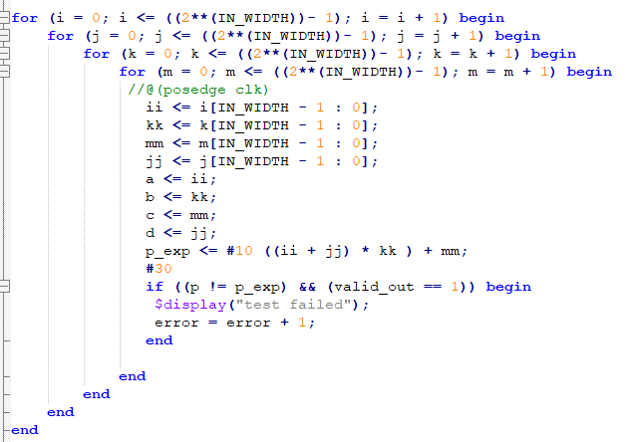
Code Snippets

Slide 7
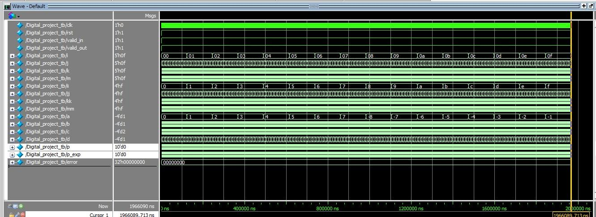
Test bench Wave form results

